Slide 1
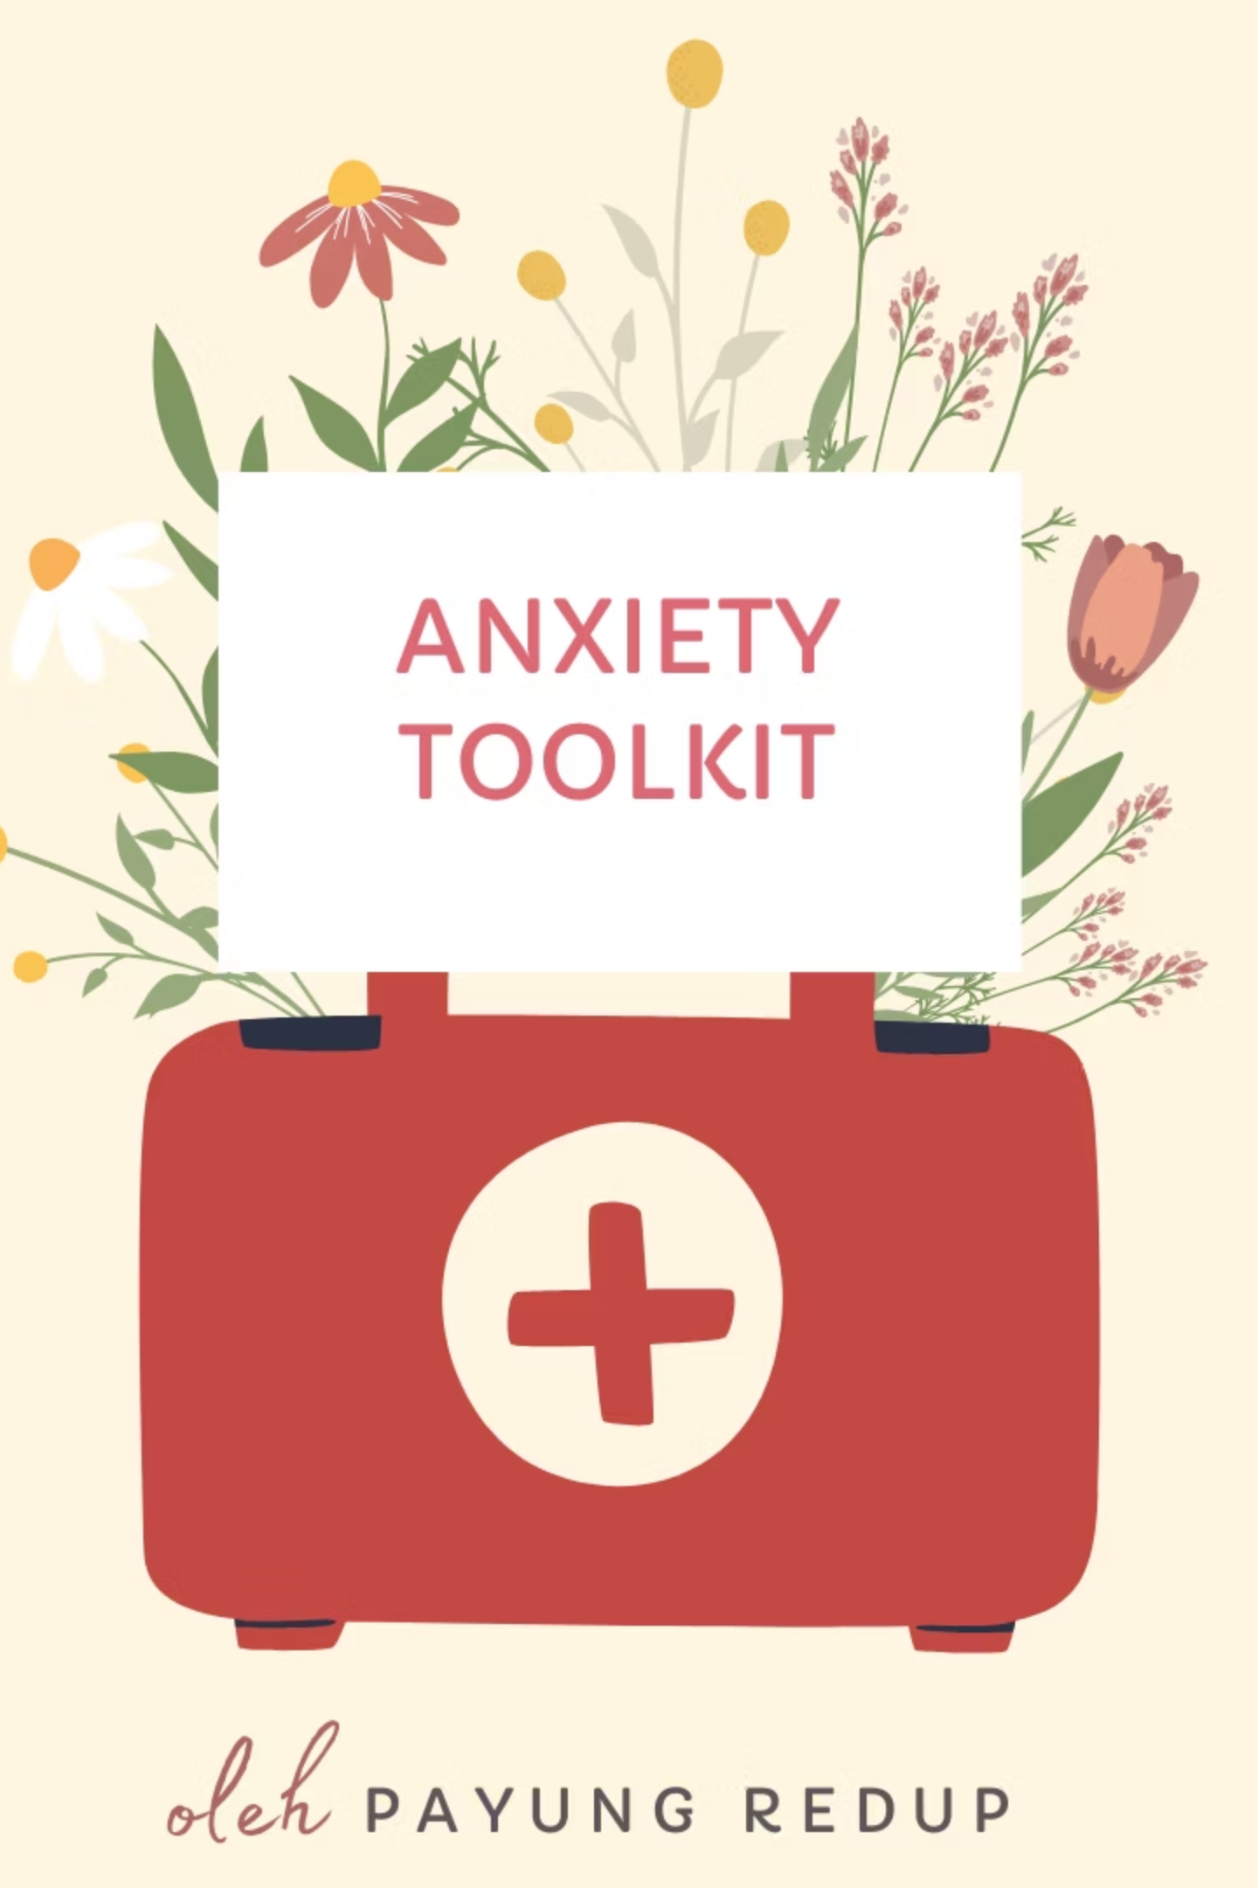
Calm in the Storm: Your Anxiety Rescue Toolkit
A 7-day ritual guide to calm your racing heart and ground your nervous system. You're safe here, and you're not alone in this journey.

Slide 2
Welcome to Your Safe Space
You downloaded this kit because your heart has been racing, your chest has been tight, and you're ready to find your way back to calm. I'm so glad you're here.
This isn't just another generic anxiety worksheet. This is your personal toolkit—designed to help you in the moment when panic hits, and to build resilience over the next seven days so those moments happen less often and feel less overwhelming.
01
02
03
Emergency Grounding Cards
5-Minute Panic Protocol
Breath-Work Guide
Print and keep in your wallet for instant access
Step-by-step guidance when anxiety strikes
Visual techniques to regulate your nervous system
04
05
Daily Check-In Prompts
Symptom Chart & Calm Script
7 days of journal exercises for building resilience
Know what you're experiencing and how to respond

Slide 3
Emergency Grounding Techniques
Print these cards and keep them accessible—in your wallet, phone case, or purse
5-4-3-2-1 Grounding
The 5-Count Breath
Your Calm Script
When anxiety spirals, use your senses to anchor back to now.
This breath pattern activates your vagus nerve and tells your body you're safe.
Read this out loud when anxiety hits:
"I am safe right now. This is my body's alarm system, not a real emergency. This feeling is uncomfortable, but it cannot hurt me. This will pass. It always passes. I can handle this."
5 things I can see
4 things I can feel
🌬️ Breathe in through nose: 1-2-3-4-5
3 things I can hear
⏸️ Hold gently: 1-2
2 things I can smell
🌬️ Breathe out through mouth: 1-2-3-4-5
1 thing I appreciate about myself
Repeat 6-8 times. Place one hand on chest, one on belly.

Slide 4

Panic Attack or Heart Attack?
If you're worried, use this chart. When in doubt, get checked out.
Panic Attack
Heart Attack
Sudden onset, peaks in 10 minutes
Can be sudden or gradual
Sharp, stabbing chest pain
Crushing, squeezing pressure
Pain stays in chest area
Pain radiates to arm, jaw, back
Better with breathing exercises
Doesn't improve with breathing
Usually subsides in 20-30 minutes
Gets worse or persists
Triggered by stress or anxiety
Can happen at rest
⚠️ IF IN DOUBT: Call emergency services. There's no shame in getting checked. Your safety matters most.

Slide 5


The 5-Minute Panic Protocol
When your heart starts racing, follow these steps in order
Stop & Assess
30 seconds
Am I in immediate danger? (No = continue)
Could this be a heart attack? (Use symptom chart)
Where can I go to feel safe right now?
Find Safety
30 seconds
Sit or lie down if possible
Go to bathroom, car, quiet room, or lean against a wall
Text someone: "Having anxiety, I'm okay, just need a minute"
Name It
30 seconds
Say out loud or in your mind: "This is a panic attack. This is anxiety, not danger. My body is trying to protect me. This will pass."
Ground
2 minutes
Choose one: 5-4-3-2-1 technique, splash cold water on face, hold ice cube, or press feet firmly into floor and notice the sensation.
Breathe
2 minutes
Use the 5-count breath. Hand on belly, hand on chest. 6-8 breaths per minute. If you lose count, start over—that's fine.
Wait & Allow
As long as needed
Let the feelings move through. Don't fight or resist. Notice them like waves: rising, cresting, falling. Be patient with your body.

Slide 6



Breath-Work Visual Guide
Box Breathing
This technique calms your nervous system by creating a steady rhythm your body can follow.
Sit comfortably, feet flat on floor
Inhale through nose: 1-2-3-4
Hold: 1-2-3-4
Exhale through mouth: 1-2-3-4
Hold: 1-2-3-4
Repeat 5 times
Imagine tracing the sides of a square as you breathe.
The Vagus Nerve Sigh
This is the fastest way to calm your nervous system
Step 1
Step 2
Step 3
Take a deep breath in through your nose and fill your lungs completely
Take a second sip of air at the top—a little more breath
Long, slow exhale through mouth, letting it all go with a sigh sound
Do this 2-3 times when you feel anxiety rising. It works immediately.

Slide 7
Your 7-Day Nervous System Reset
Each day, spend 10-15 minutes with one practice. This isn't about perfection—it's about building your calm muscle.
Day 1: Safe Space Inventory
1
Walk through your home and identify 3 places where you feel most safe. These become your panic safe zones. Journal about what makes them feel safe and how to enhance that feeling.
2
Day 2: Breath Awareness
Set a timer for 5 minutes. Sit quietly and notice your breath without changing it. Where do you feel it? Chest? Belly? Nose? Just observe without judgment.
Day 3: Grounding Practice
3
Do the 5-4-3-2-1 technique when you're calm. Practicing in calm moments makes it easier to access when you're anxious. Notice which sense is easiest to focus on.
4
Day 4: Cold Therapy
Try 3 different cold techniques: splash face with cold water, hold ice cube, drink ice water. Notice which feels most grounding. Cold interrupts the panic cycle instantly.
Day 5: Movement & Release
5
When stress comes up, shake your body for 60 seconds. Shake your hands, arms, legs—let it look silly. This completes the stress cycle and releases trapped energy.
6
Day 6: Self-Compassion Script
Write your own calm script. What words make you feel safe? What do you need to hear? Use Card 4 as a template, but make it uniquely yours.
Day 7: Integration & Reflection
7
Review your week. What helped? What will you keep doing? Identify your top 3 tools and commit to one practice going forward. Celebrate how far you've come.

Slide 8
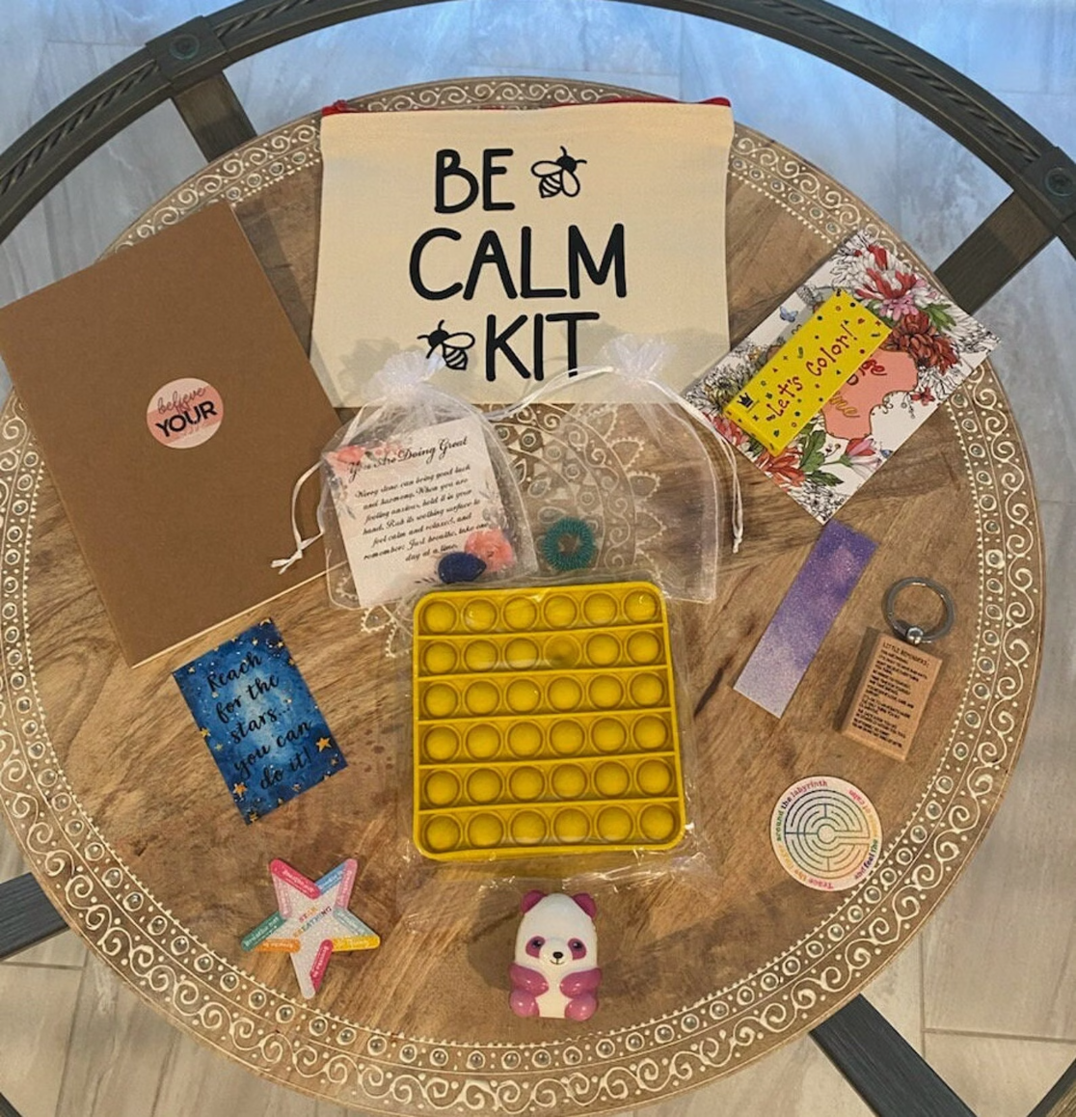
Building Your Anxiety First-Aid Kit
Create a physical kit you can grab when anxiety hits
Essential Items
Printed grounding cards
Stress ball or fidget toy
Ice pack or cooling gel mask
Lavender oil or calming scent
Comfort & Connection
Earbuds + calm playlist
Small snack (anxiety depletes energy)
Water bottle
Photo of someone/something safe
Where to keep it: Bedroom, car, office drawer, or purse—anywhere you can access it quickly when anxiety strikes.
Reference Materials
Your personal calm script
Emergency contact list
This toolkit guide

Slide 9
When to Seek Extra Support
This toolkit is powerful, but it's not a replacement for professional help. You deserve support, and asking for help is strength, not weakness.
Frequency & Intensity
Avoidance Patterns
Daily Functioning
Panic attacks are happening multiple times a week, or anxiety is becoming more intense despite using these techniques consistently.
You're avoiding places, activities, or people because of fear of panic. Your world is getting smaller instead of expanding.
Anxiety is affecting your work, relationships, sleep, or ability to handle daily responsibilities. You feel like you're just surviving, not living.
Coping Mechanisms
Lack of Relief
You're using substances (alcohol, drugs, medications) to manage anxiety, or you have thoughts of self-harm.
The techniques in this guide aren't providing relief after consistent practice over several weeks. Different support may be needed.
Consider reaching out to a therapist, counselor, or anxiety specialist. Many offer virtual sessions, and there are affordable options available. You don't have to do this alone.

Slide 10

Your Next Steps
You've taken a huge step by reading this guide. That takes courage. Here's what to do now to turn knowledge into action:
Print the Cards
Schedule Day 1
Print the grounding cards and put them somewhere accessible—wallet, purse, or bedside table.
Choose your Day 1 practice and put it in your calendar. Set a reminder so you don't forget.
Build Your Kit
Share & Connect
Gather items for your anxiety first-aid kit this week. Having it ready brings peace of mind.
Share this with someone you trust so they know how to support you when anxiety strikes.
Remember: Healing Isn't Linear
Some days will be easier than others. Some techniques will work better than others. That's all part of the process. Be patient with yourself—you're rewiring decades of nervous system patterns, and that takes time.
We're here if you need us. If you want gentle, personalized guidance working through anxiety—or if you just need someone to talk to who understands—we're here.
WhatsApp: +254 720 202 299
Email: hello@arcaneguides.com
No pressure. No judgment. Just support whenever you need it.
You're doing beautifully. Keep going.

